Slide 1


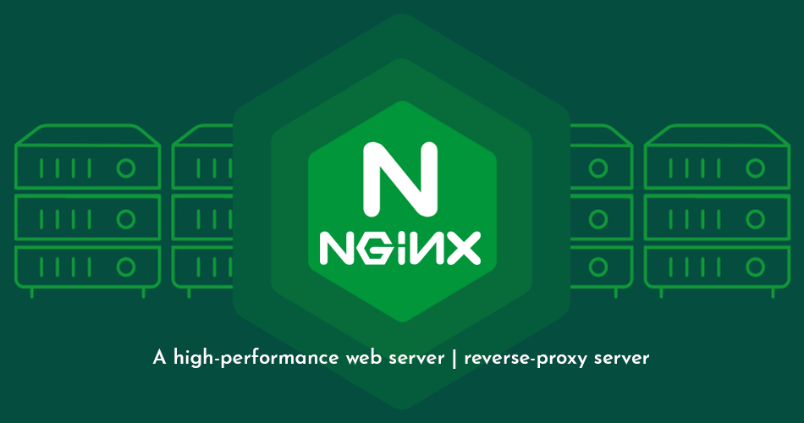
PRESENTED BY: Shrusti Patel
Roll No :12
Class :M.SC.CS sem-1
NGINX

Slide 2
Topics
Introduction to Nginx
Common Use Cases
Company Background
Core Capabilities of Nginx
Installation Steps
Reverse Proxy & Load Balancer Architecture
Advantages & Disadvantages of Nginx
Learning Resources & Course Certifications
Conclusion

Slide 3

Introduction to Nginx
Nginx is a high-performance web server and reverse proxy server that is widely used for serving static content, handling high concurrency, and load balancing.
What is Nginx?
Nginx is a powerful, open-source web server known for its high performance, stability, and low resource consumption.
Why Nginx Matters:
“In modern web applications, traffic can spike unexpectedly. Nginx helps websites stay fast and responsive even under heavy load.”
“It’s not just a web server—it can also act as a load balancer, cache server, and reverse proxy.”

Slide 4
Common Use Cases of Nginx
Content
Website Hosting
API Gateway
Reverse Proxy for Applications
Explanation
Website Hosting:
“Nginx can serve static websites or web applications efficiently, handling thousands of concurrent users with minimal resources.”
API Gateway:
“It acts as an entry point for APIs, routing requests, applying security rules, and managing traffic between clients and backend services.”
Reverse Proxy:
“Nginx sits between clients and application servers, forwarding requests, caching responses, and balancing load across multiple servers to improve performance and reliability.”

Slide 5
Company Background
Content
Founder: Igor Sysoev (2002)
First Public Release: 2004
Nginx, Inc.: Formed in 2011 for commercial support
Adoption: Powers top companies like TikTok, Airbnb, Netflix, WordPress, GitHub
Explanation :
Origin:
“Nginx was created in 2002 by Igor Sysoev to handle high-traffic websites efficiently.”
Purpose:
“It was designed to serve thousands of simultaneous connections with very low memory usage.”
Growth & Adoption:
“Released publicly in 2004, it quickly gained popularity for its performance and scalability.”
“Millions of websites, including Netflix, WordPress, and Dropbox, use Nginx today.”
“In 2011, Nginx, Inc. was formed to offer commercial support and enterprise features.

Slide 6
Core Capabilities of Nginx
Web Server: Serves static files (HTML, CSS, JS, images) and supports dynamic content with backend servers.
Reverse Proxy: Acts as an intermediary between clients and servers, improving security and efficiency.
Load Balancer: Distributes requests across multiple servers for better performance and fault tolerance.
HTTP Cache: Improves speed and reduces server load by caching frequently accessed content.
Scalability & Reliability: Uses an event-driven architecture to handle thousands of concurrent connections efficiently.

Slide 7

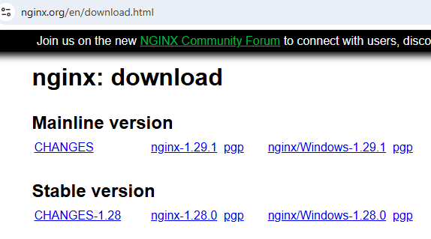
Nginx Download Steps
2
Step : 1
1
Visit the official website: : nginx.org
Choose the latest version compatible with your operating system (Windows,

Slide 8
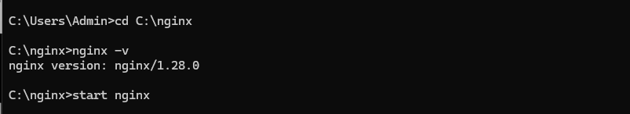
Nginx Download Steps
2
Step : 2
Download for Windows
Click on the Windows .zip package.
Extract the Files
Unzip the downloaded file to a simple location, e.g., C:\nginx.
Start Nginx
Open Command Prompt → go to the Nginx folder:
1

Slide 9
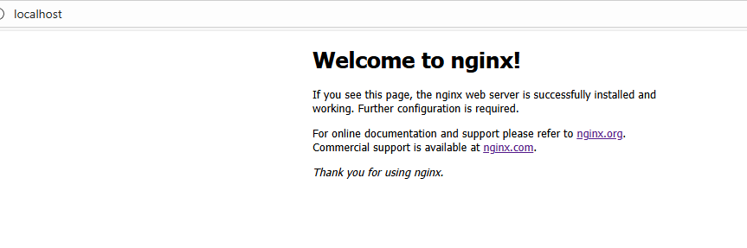
Step : 3
Start Nginx
Open Command Prompt → go to the Nginx folder:
cd C:\nginx start nginx

Slide 10
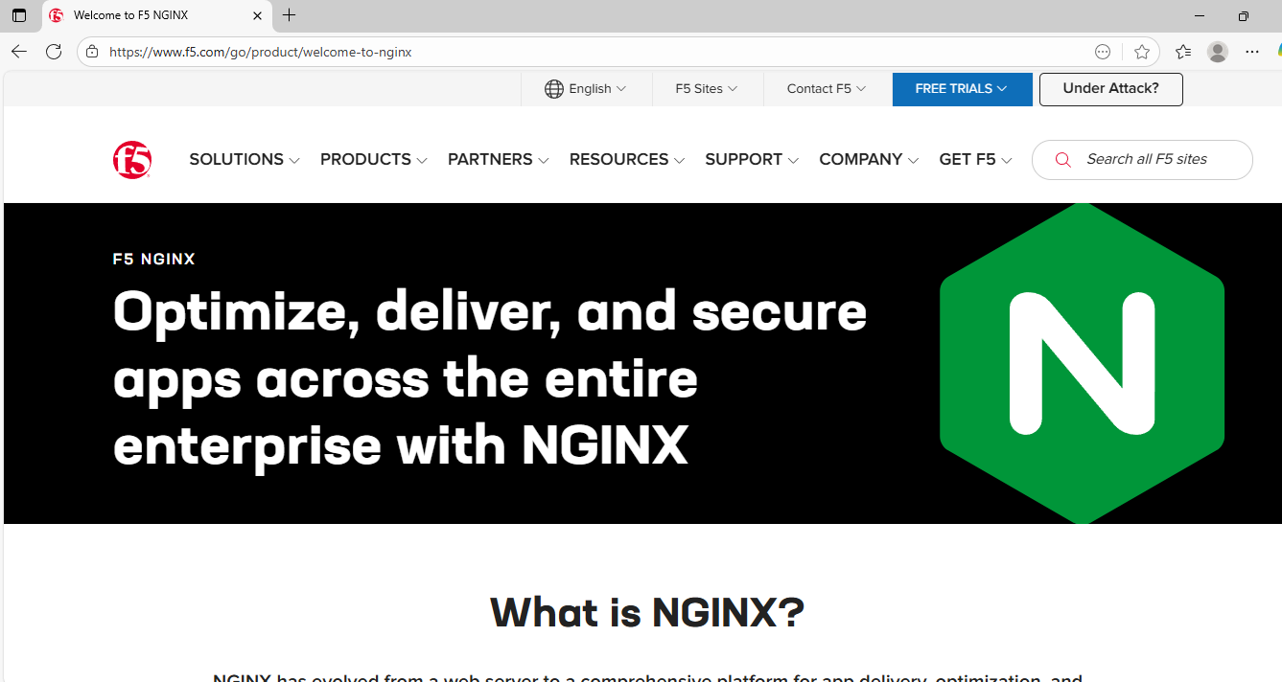
Step : 4
Check Installation
Open your browser → type http://localhost
You should see the Nginx Welcome Page.

Slide 11
Nginx Methodology (How Nginx Works)
🔹 Definition of Methodology
The methodology of Nginx refers to the working approach or internal mechanism that enables it to handle thousands of simultaneous requests efficiently while consuming minimal system resources.
Unlike traditional web servers that use a process-per-request or thread-per-request model, Nginx uses an event-driven, asynchronous, non-blocking architecture — the core reason behind its exceptional performance and scalability.

Slide 12

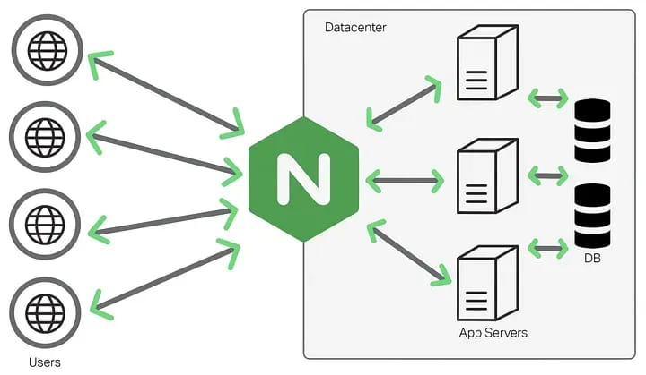
Nginx: Reverse Proxy & Load Balancer Architecture”

Slide 13
Nginx Architecture
Content (for slide):
Event-driven, asynchronous architecture
Handles multiple requests efficiently
Uses worker processes
Event-driven model:
“Nginx can handle thousands of users at the same time without starting a new program for each user.”
Worker processes:
“Small worker programs handle requests quickly, keeping Nginx fast and lightweight.”

Slide 14
Feature / Aspect | Nginx | Apache HTTP Server | LiteSpeed Web Server | Caddy Server
Architecture Model | Event-driven, asynchronous | Process/thread-based (multi-processing modules) | Event-driven (optimized for performance) | Event-driven (Go-based)
Performance | Very high under heavy load due to async handling | Slower under high concurrency | Faster than both Apache and Nginx in dynamic content | Excellent, automatic optimization for HTTPS and caching
Configuration & Ease of Use | Requires manual configuration via config files | More complex; .htaccess supported for per-directory config | GUI and Apache-compatible config, easier to manage | Extremely easy; automatic HTTPS and simple config syntax

Slide 15



Advantages and Disadvantages of Nginx
1
Advantages
High Performance
Reverse Proxy & Load Balancing
Low Resource Usage
Security Features
Flexible Web Serving
Reverse Proxy for Applications

Slide 16

Advantages and Disadvantages of Nginx
2
Disadvantages
Hard to set up for new users
Limited Support for .htaccess
Fewer modules compared to Apache
Difficult to customize at first

Slide 17

Video Tutorials
Online Learning Resources
Various platforms offer tutorials from beginner to advanced levels.

Slide 18

Certification for Nginx
Certification Programs
Organizations provide certifications to validate expertise.

Slide 19
Conclusion on Nginx
Nginx is a high-performance and lightweight web server widely used for modern websites and applications. It can efficiently handle thousands of connections, making it faster than many traditional servers. With features like reverse proxy, load balancing, and strong security, it ensures reliability and scalability. Although it may be difficult for beginners to configure, its efficiency and flexibility make it a top choice.

Slide 20
THANK YOU

